Slide 1




Churn Analysis – Telecom Industry
This presentation will discuss key insights from a thorough analysis of churn data for a telecommunications company. We will examine customer demographics, contract types, and billing details to uncover patterns and trends related to customer churn.
by Sasikumar Sha

Slide 2

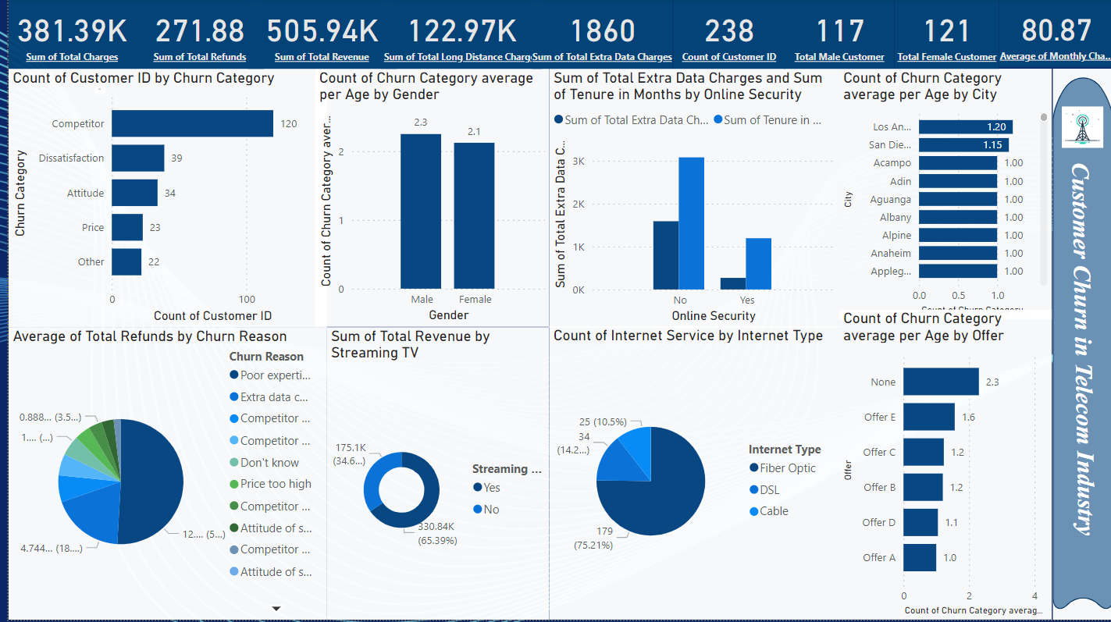
Total Customers and Churn Rate
1
Total Customers
2
Churn Reason
The total number of customers involved in the Analysis was 238, whereas 117 male customers & 121 Female Customers
The Highest Churned reason ‘’ Competitor’’, lowest churned ‘’ price and Other’’
3
Churn Patterns
Churn tends to be higher among certain customer segments, such as males which is 57.67%, whereas female customers 54.41%

Slide 3

Churned Customer Age & Location
1
Average Age
The average age of churned Male customers is 52 years old,
Whereas the Female customer is 52 years old.
2
Age Range
Churned customers span a wide age range, from 18 to 65 years old.
3
Churned cities
Los Angeles has the highest which is 30.76% followed by San Diego at 29.47% , Rest of the cities has equally churned weightage 25.63%

Slide 4
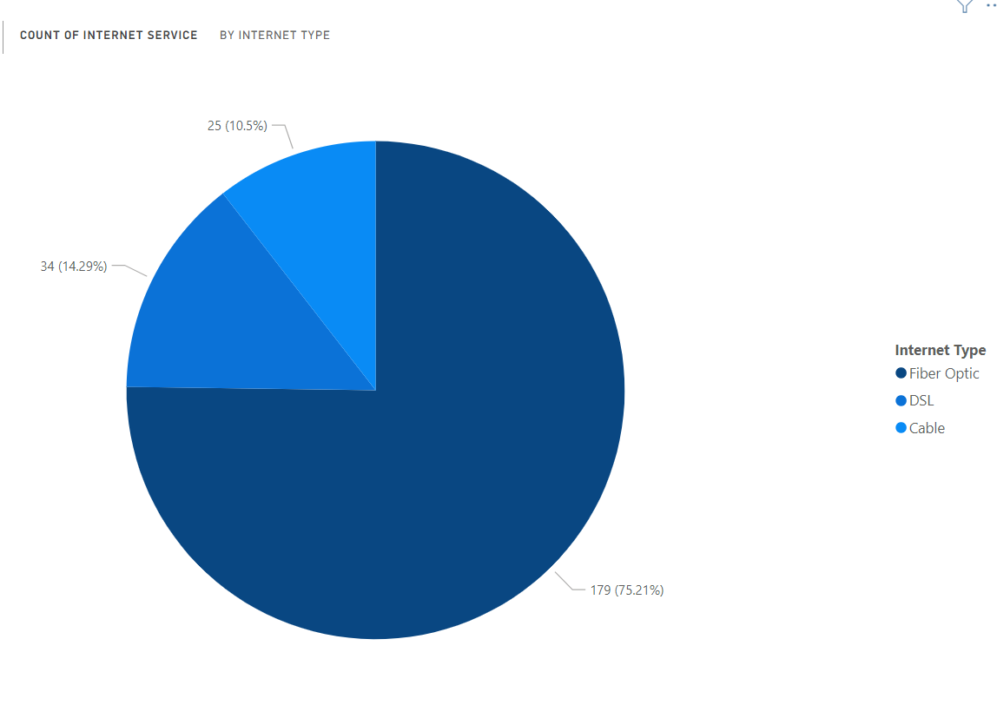
Count of Internet Services by Internet Type
Type of Internet
Fiber Optic - 179 Customers have fiber optic out of 238, Which is 75.21%
DSL Method - 34 customers have DSL out of 238, Which is 14.29%
Cable method - 25 Customers have Cable out of 238, Which is 10.5%

Slide 5



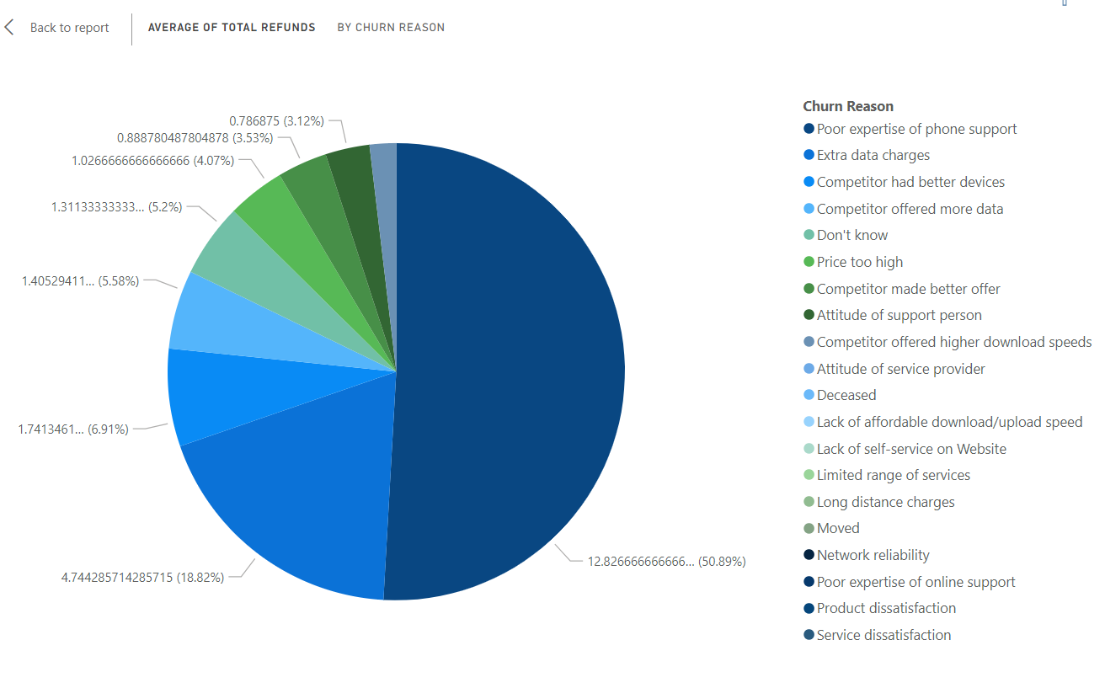
Average of Total Refunds by Churn Reason
1st Highest reason is Poor
Expertise of phone support
Which is 50.89%
2nd Highest reason is Extra
Data charges, which is 18.82%
3rd Highest reason is Competitor had better devices, which is 6.91%

Slide 6

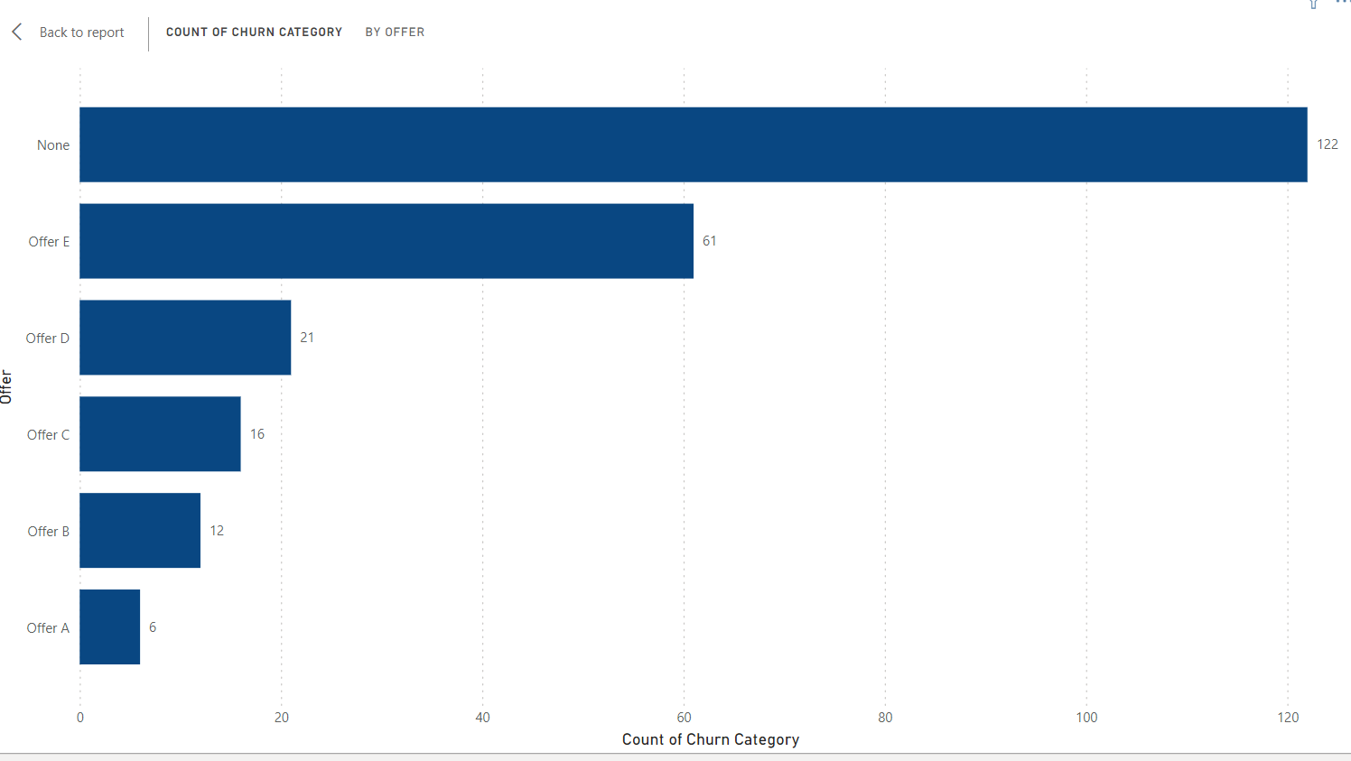
Churned Category by Offer
Highest churn customers are no offer category
followed by offer E customers are 2nd Highest
Churned customer.
Whereas offer A have the lowest category
of churned customers followed by Offer B

Slide 7

Total Charges: Churned vs. Non-Churned
Sum of Total Charges -381.39K
Sum of Total
Refund – 271.88
Sum of Total Revenue 505.94k
Long Distance Charges
– 122.97K
Total Extra data
Charges - 1860
Total count of Customer Id - 238
Total Male Customer - 117
Total Female
Customer - 121
Average Monthly
Charges – 80.87
The data shows churned customers tend to have higher total charges, indicating cost may be a significant factor in the churn decision.

